Slide 1





Data Spark: Illuminating
Insights for
Global Electronics

Slide 2
Problem Statement:
As part of Global Electronics' data analytics team, you are tasked with conducting a comprehensive Exploratory Data Analysis (EDA) to uncover valuable insights from the company’s data. Your goal is to provide actionable recommendations that can enhance customer satisfaction, optimize operations, and drive overall business growth.
Global Electronics, a leading retailer of consumer electronics, has provided you with several datasets containing information about their customers, products, sales, stores, and currency exchange rates. The company seeks to leverage this data to better understand their business and identify areas for improvement.

Slide 3
Data sets
We have 5 datasets:
Customers details
Products details
Sales details
Stores details
Exchange rates

Slide 4

Data Pre-processing & EDA

Slide 5
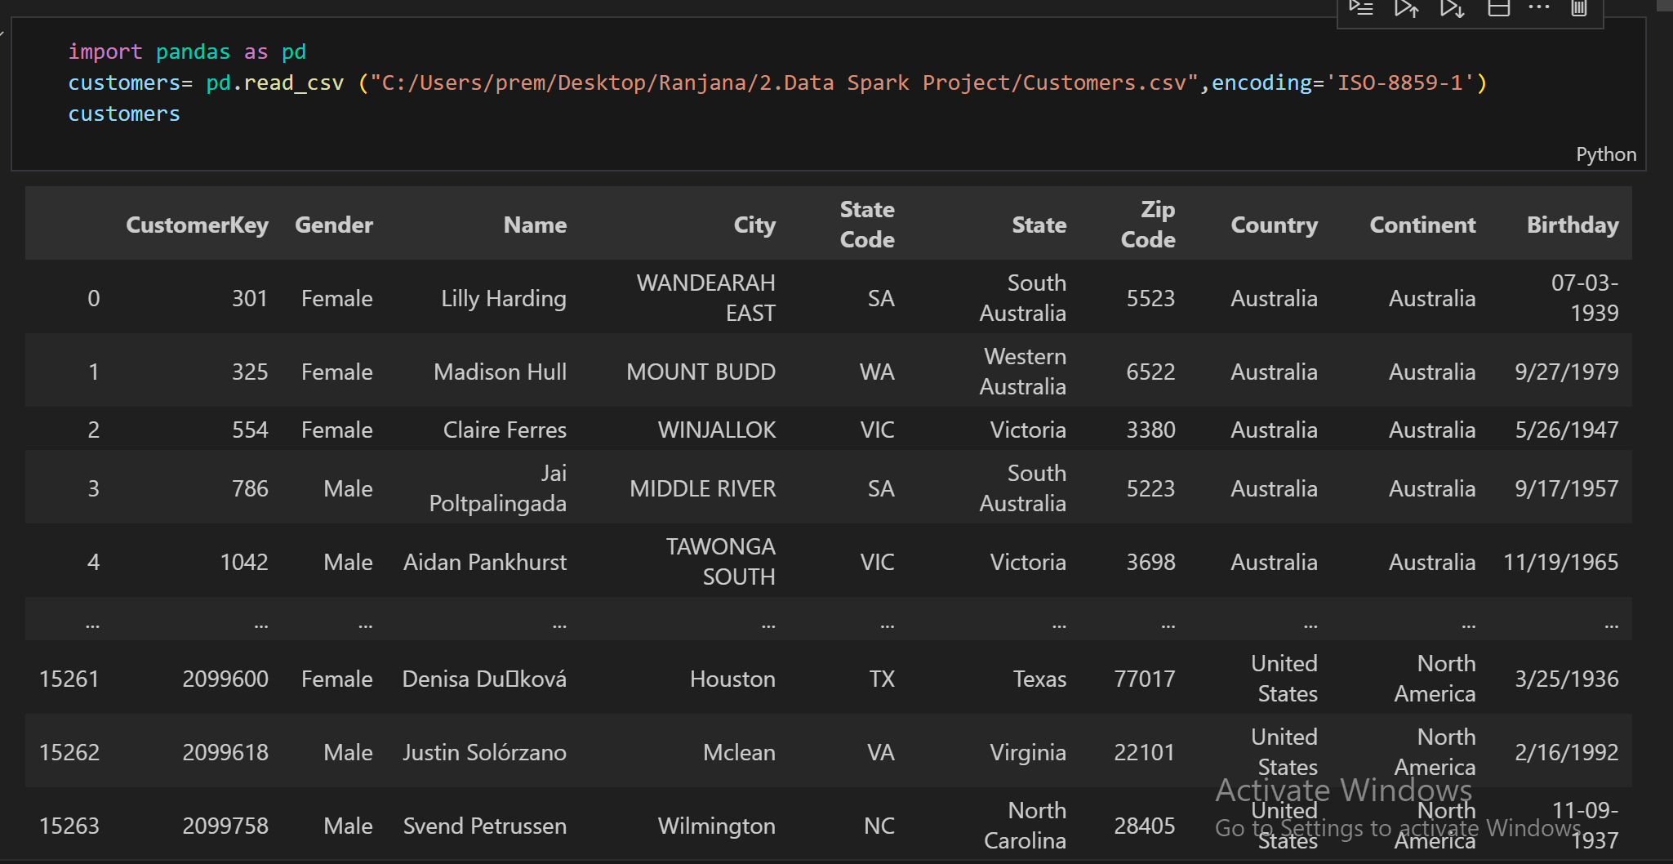
1.Customers Data Set
It has 10 columns and 15266 rows

Slide 6
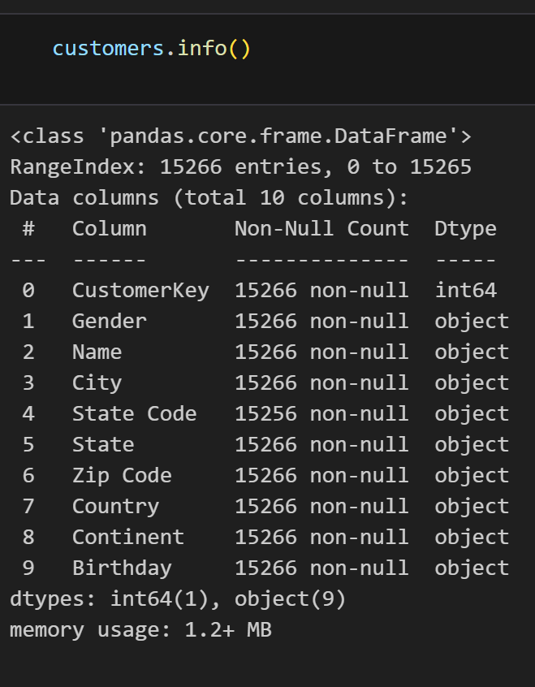
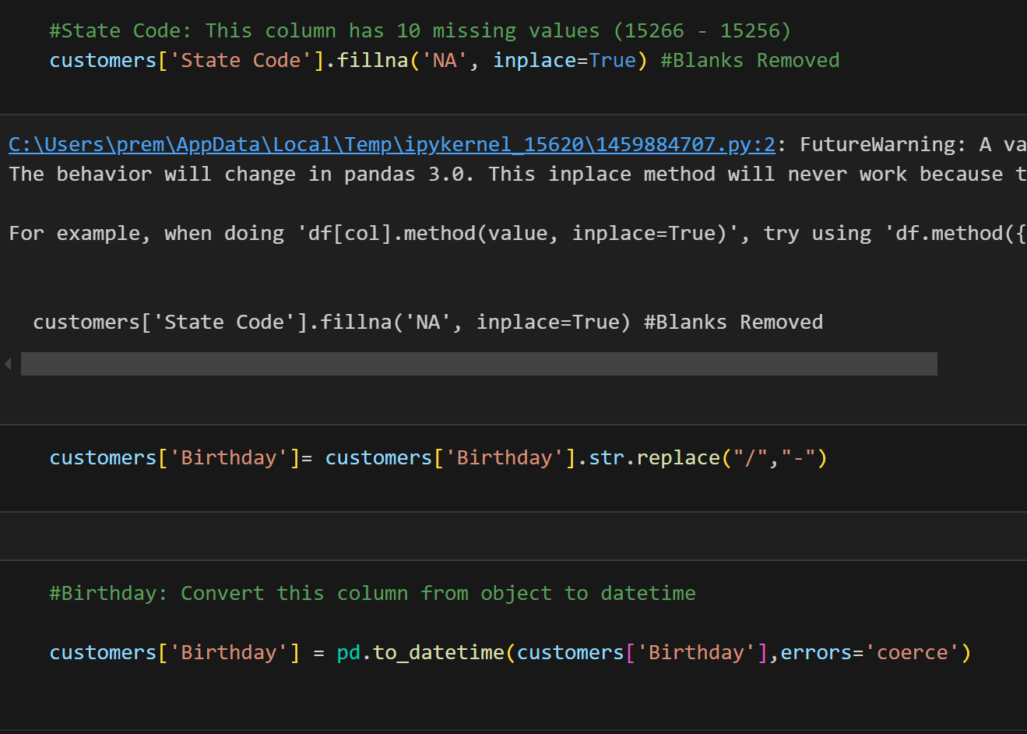
Checking null values And Replace
Customers Table Information
State code Blank Removing & Customer Birthdates format changing

Slide 7

Duplicate checking and convert new csv

Slide 8
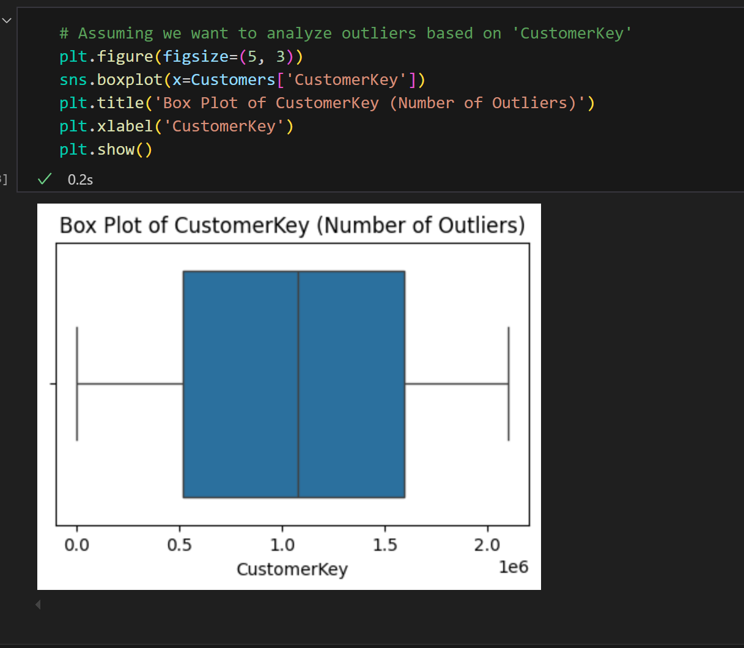
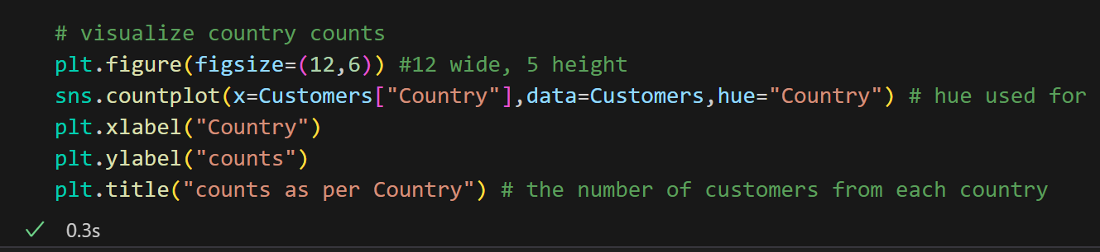
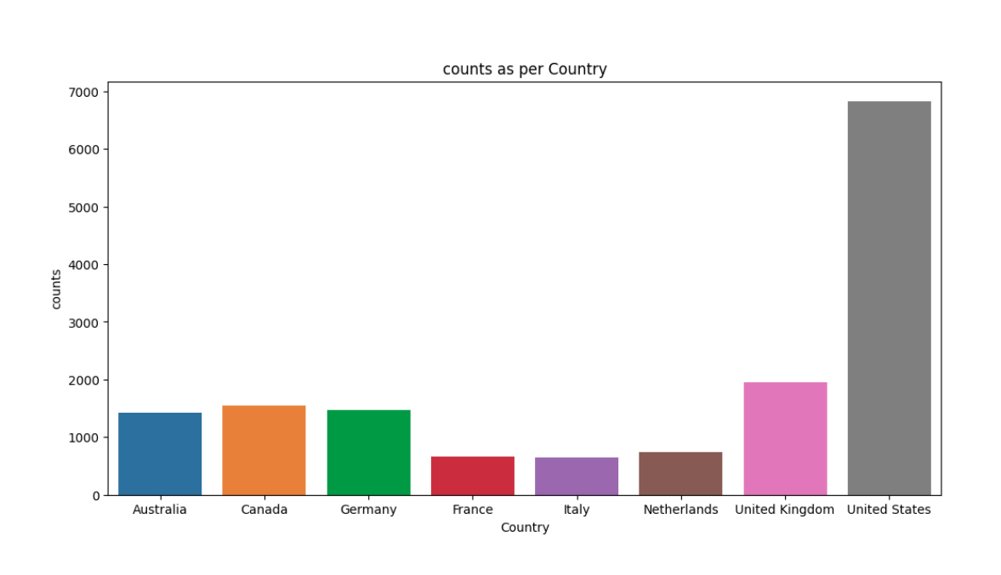
Outliers checking & Count plot to Analyse Categorical Column
Outliers checking using box plot. No outliers in this dataset
In the Dataset we can see customers are higher count in United States other than other countries

Slide 9
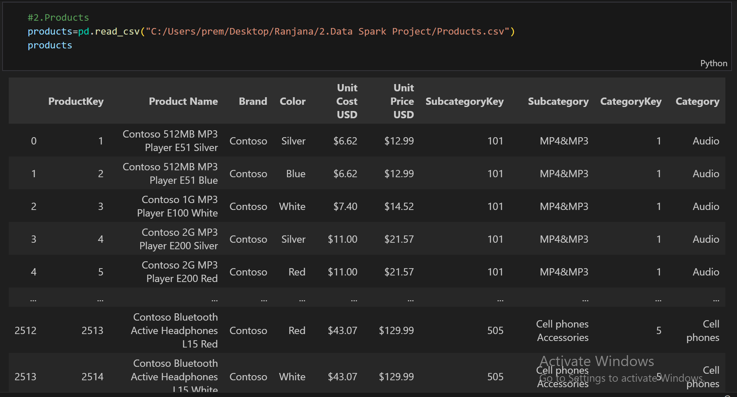
2.Products Dataset

Slide 10
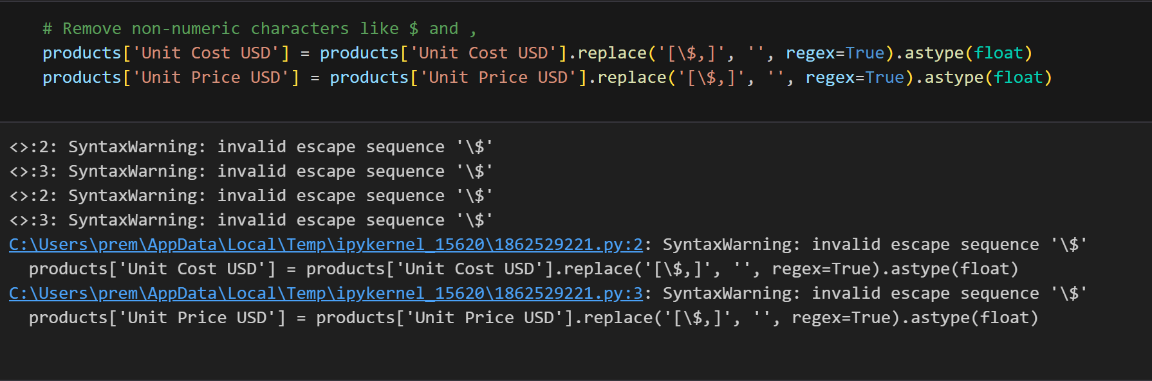
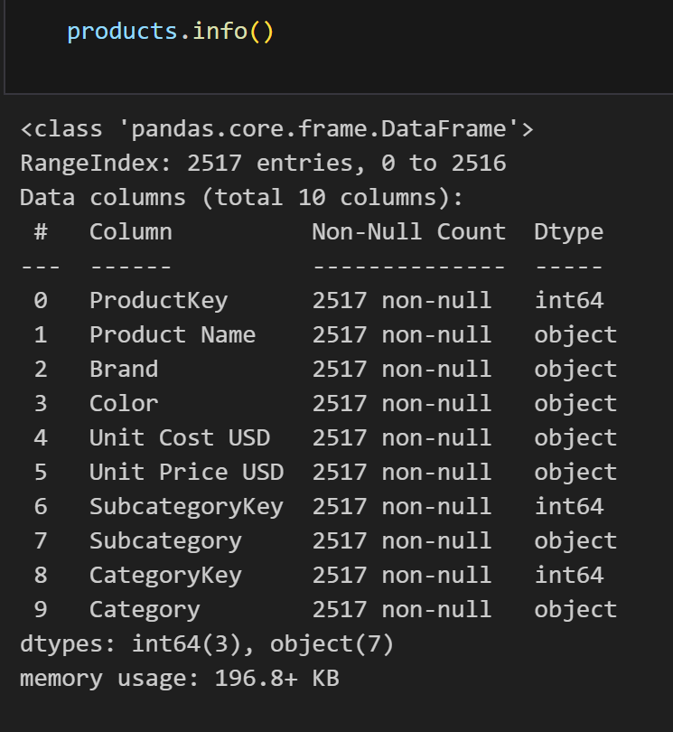
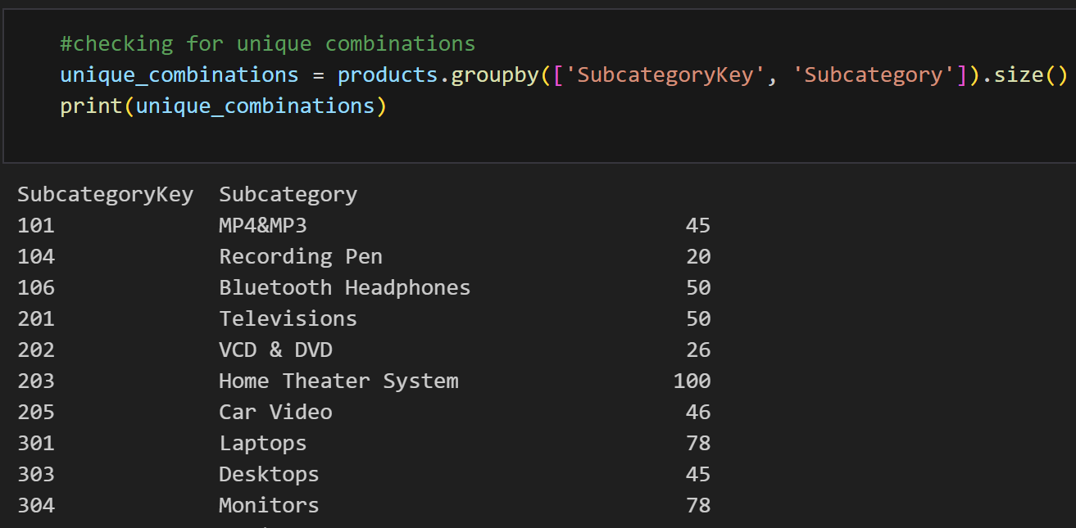
Null & duplicates checking
From this products dataset there is no null and duplicates values
Converting Data types and Checking for unique combinations

Slide 11
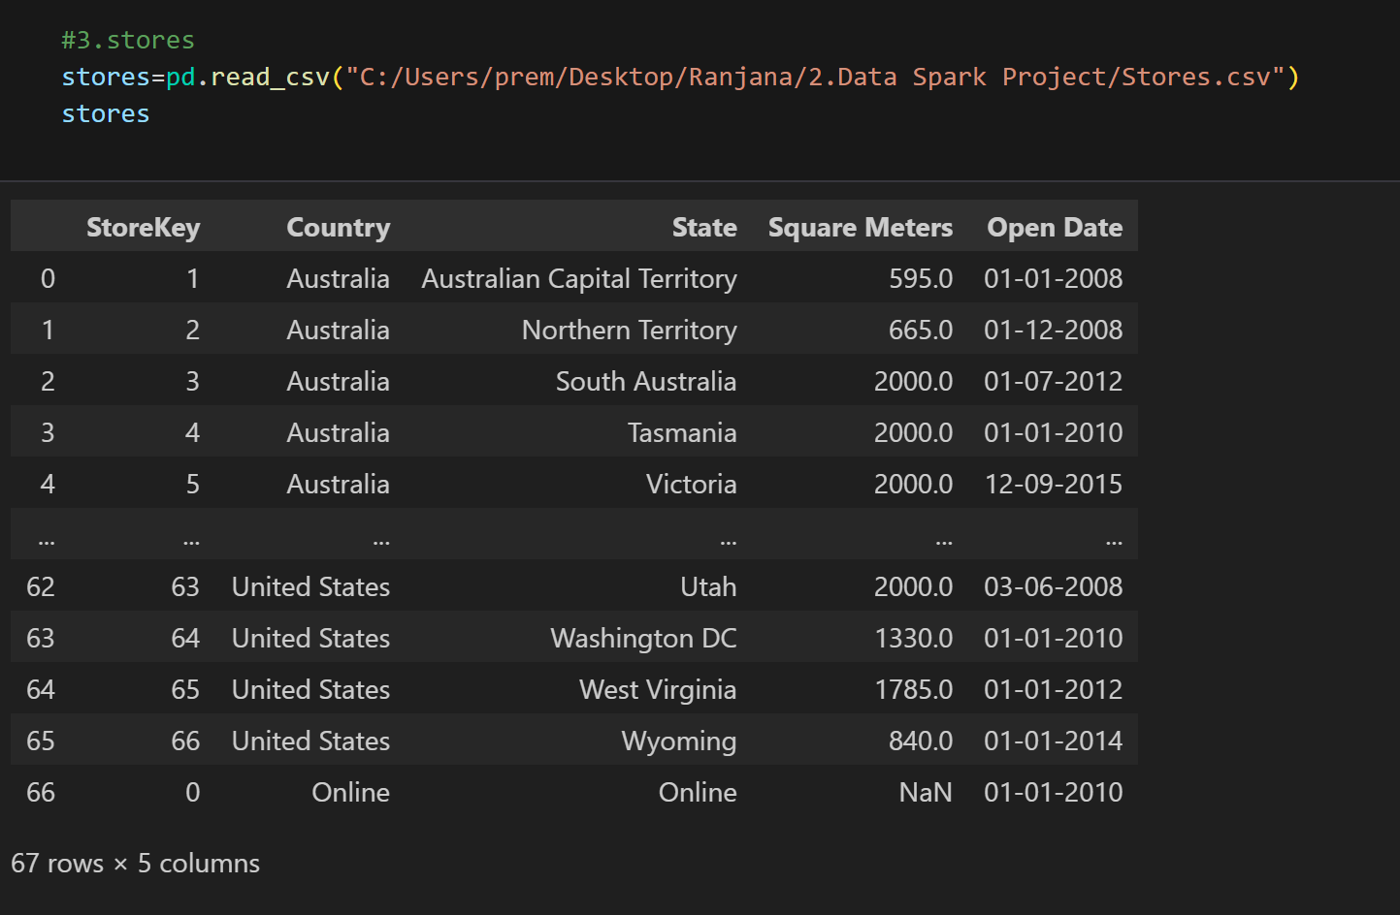
3.Stores Dataset

Slide 12
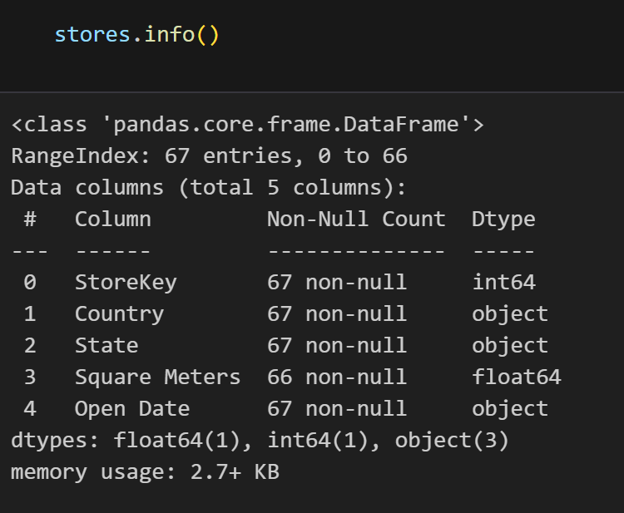
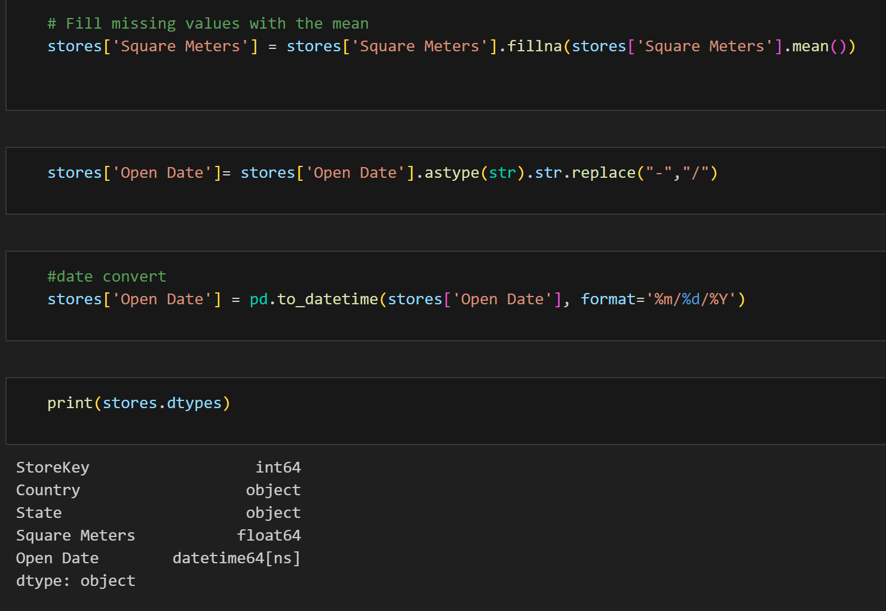
Null & Duplicates Checking
Stores Dataset Information
Fill missing Store square meter values with the mean and store open date format changing

Slide 13
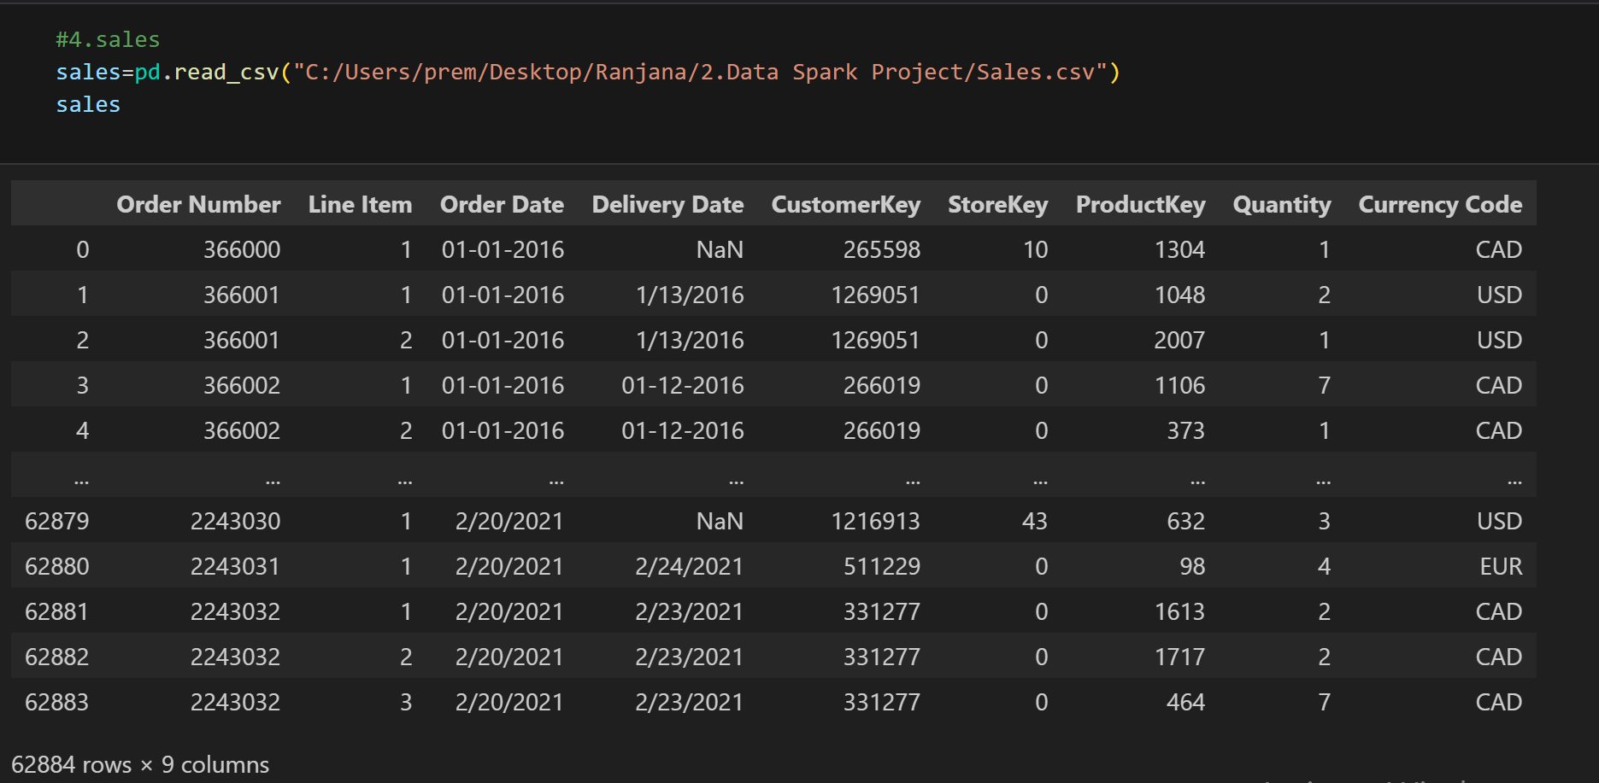
4. Sales dataset

Slide 14
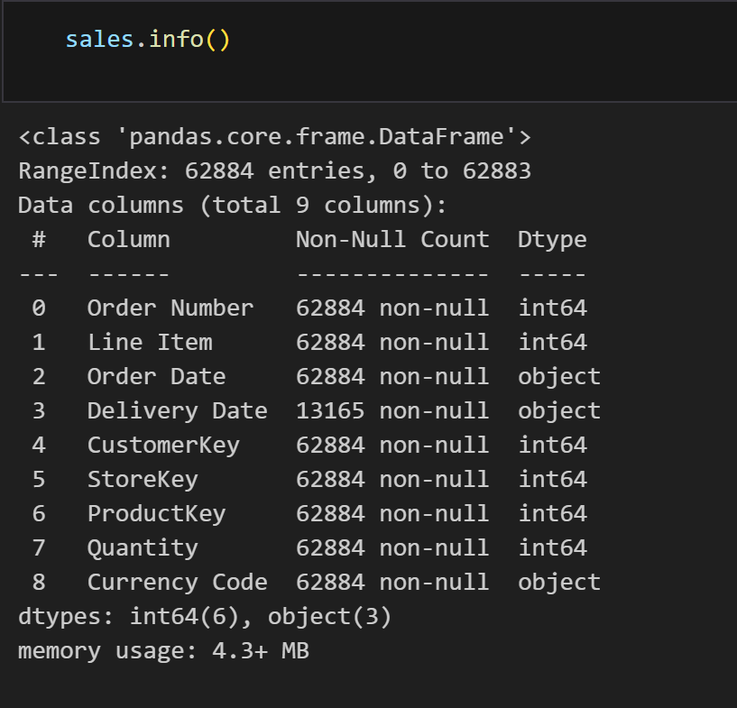
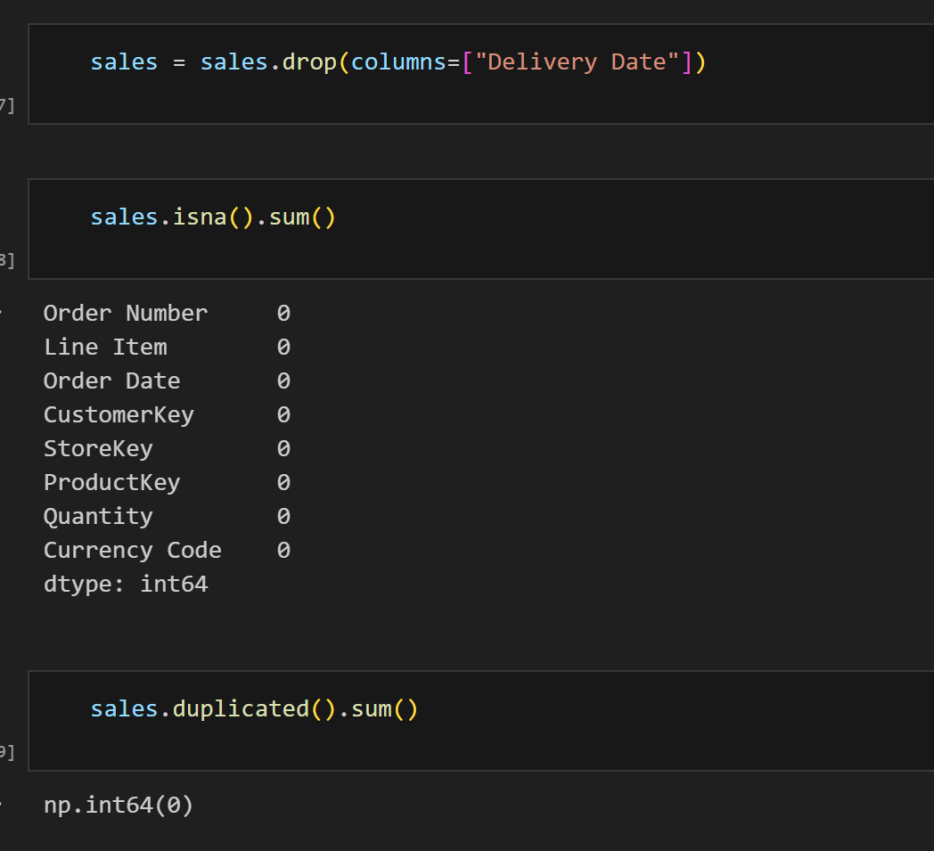
Null & Duplicates Checking
Sales Dataset information
Here we delete Delivery Date columns
due to lot of data missing and the checking duplicate

Slide 15
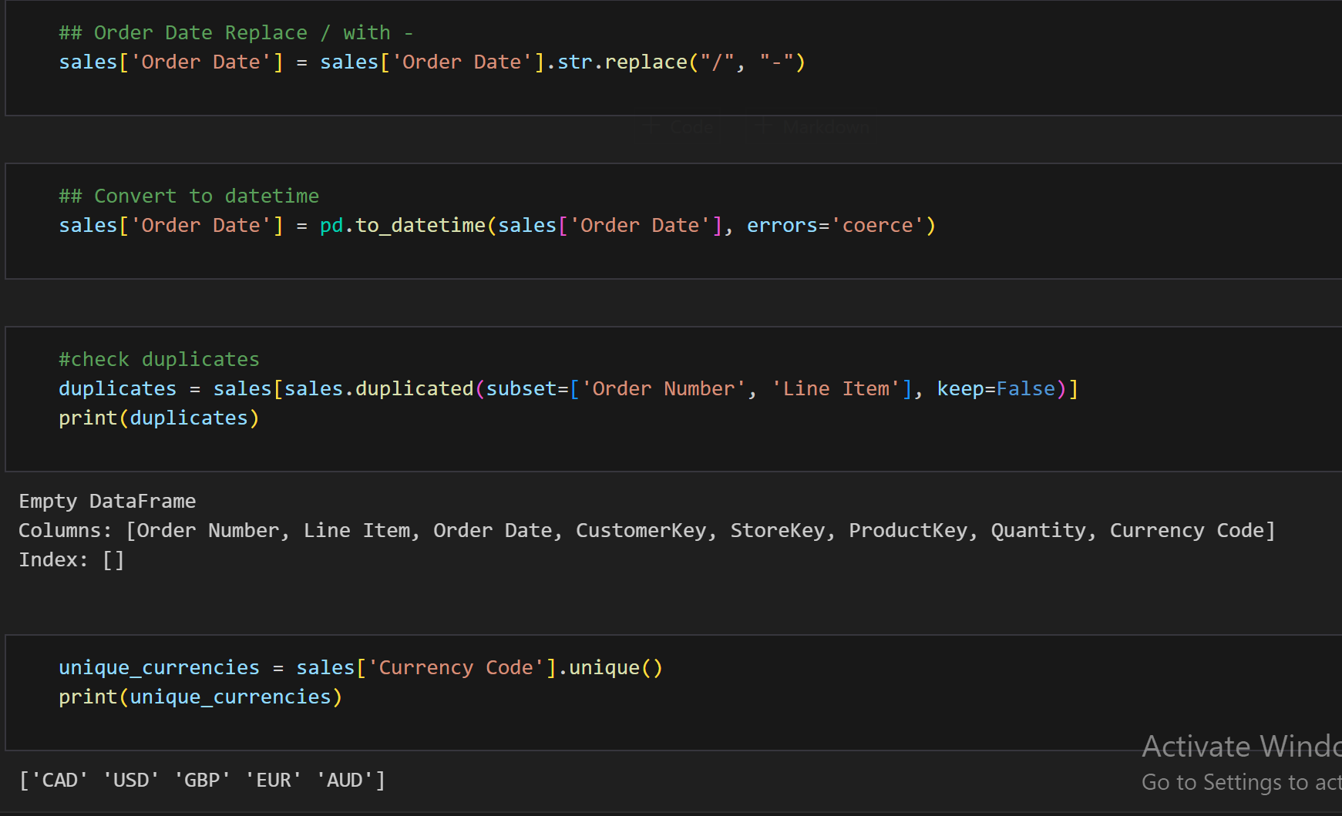
Converting data types

Slide 16
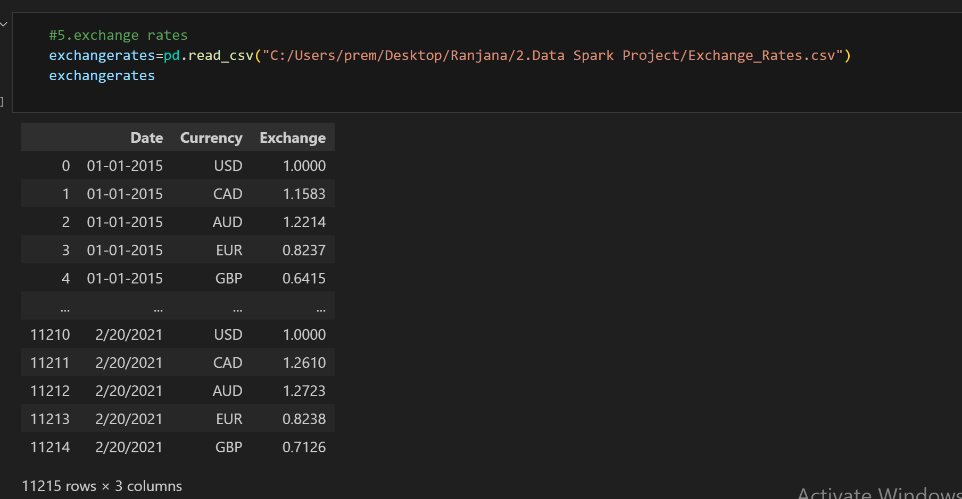
5.Exchange Rates Dataset

Slide 17
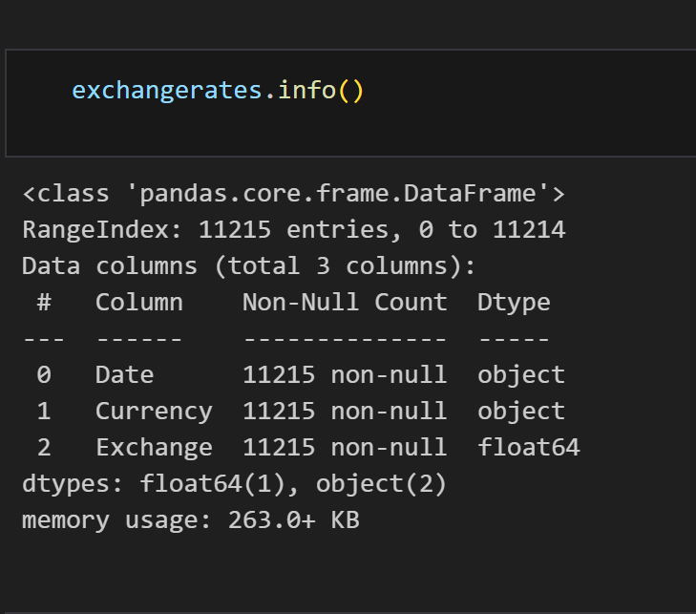
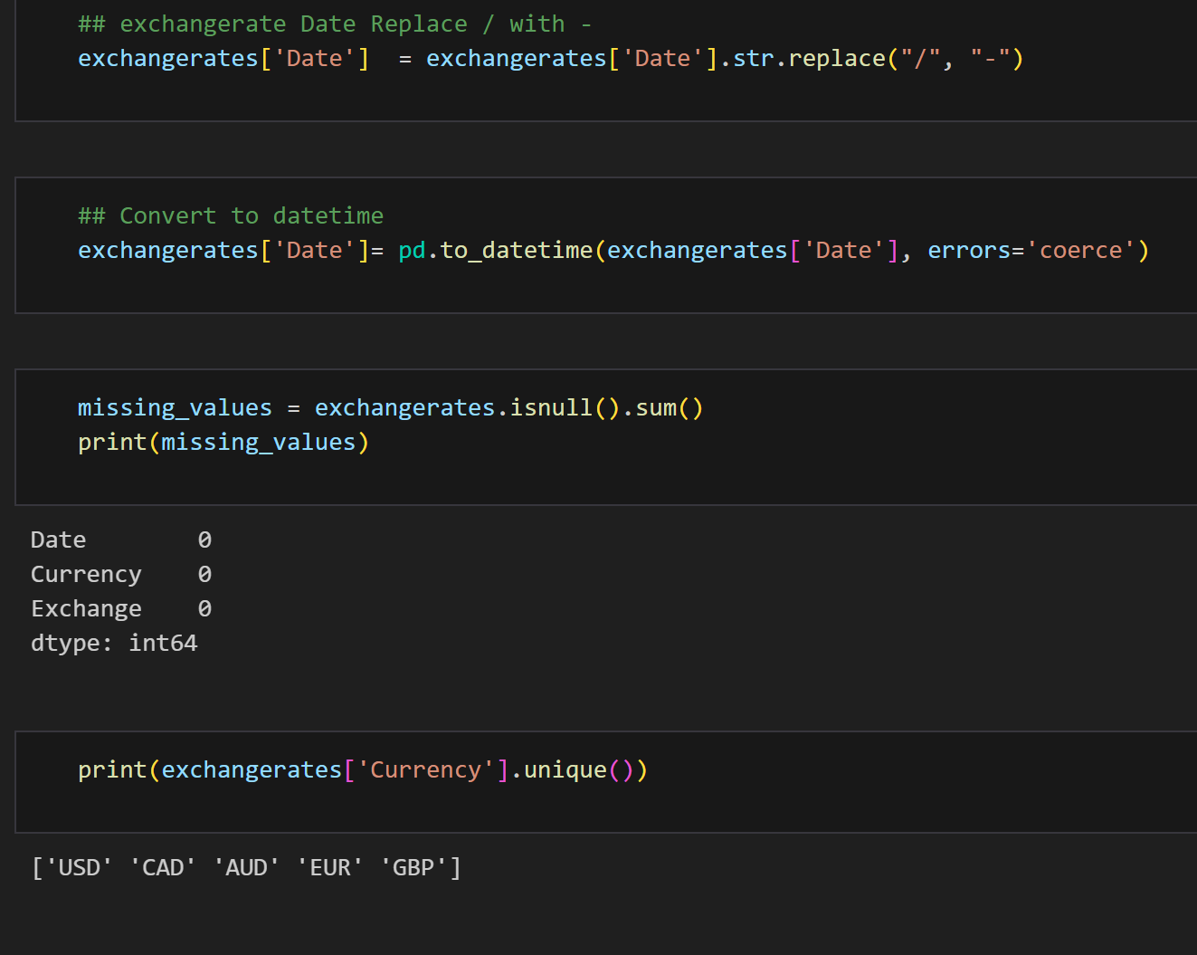
Null & Duplicates Checking
Exchange rates dataset information
Converting Date format and check unique values

Slide 18
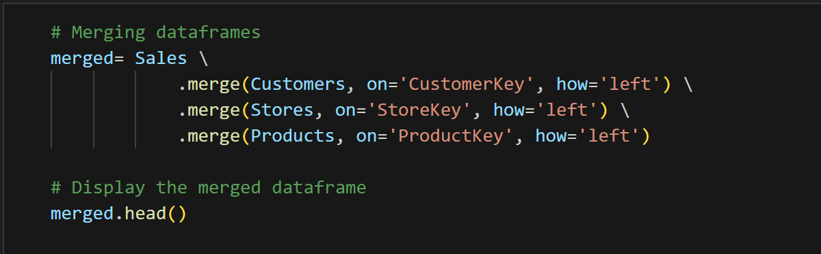
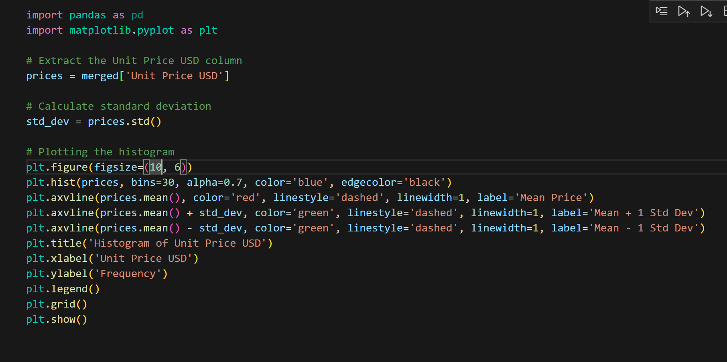
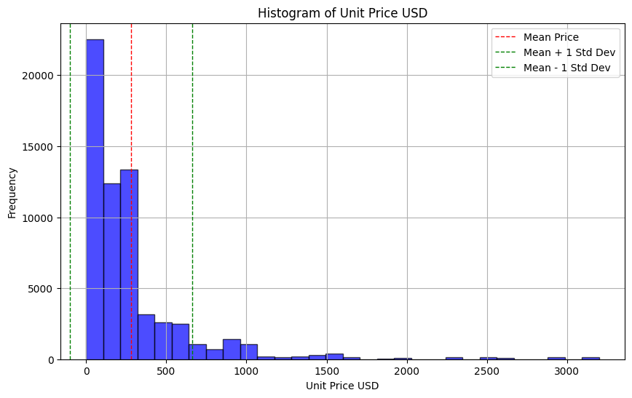
Merging datasets
Merging customer and product table with sales table using their respective unique key

Slide 19
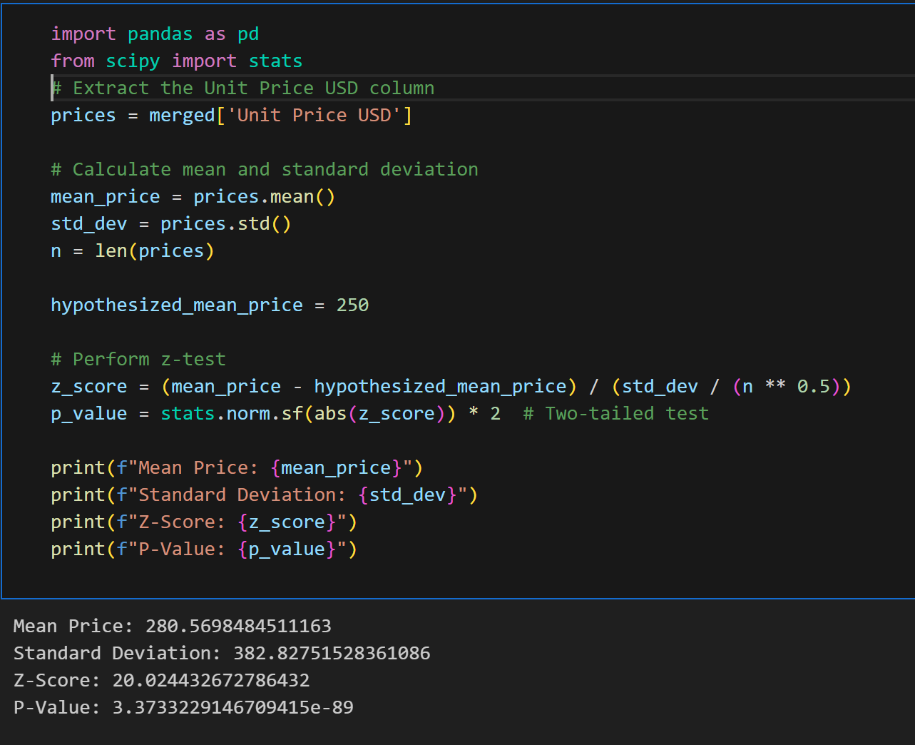
Simple Z Test

Slide 20
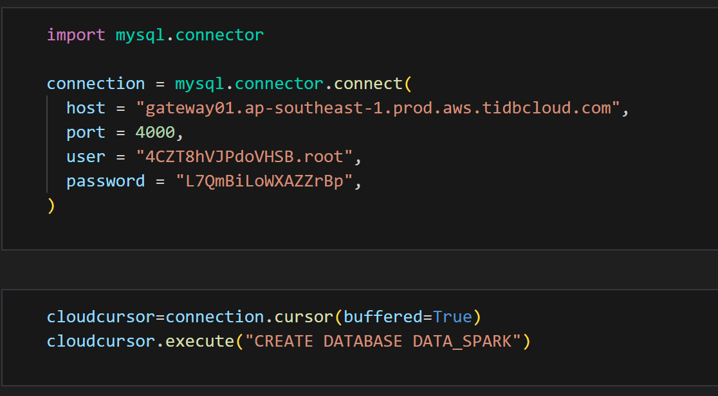
Create the sql database

Slide 21
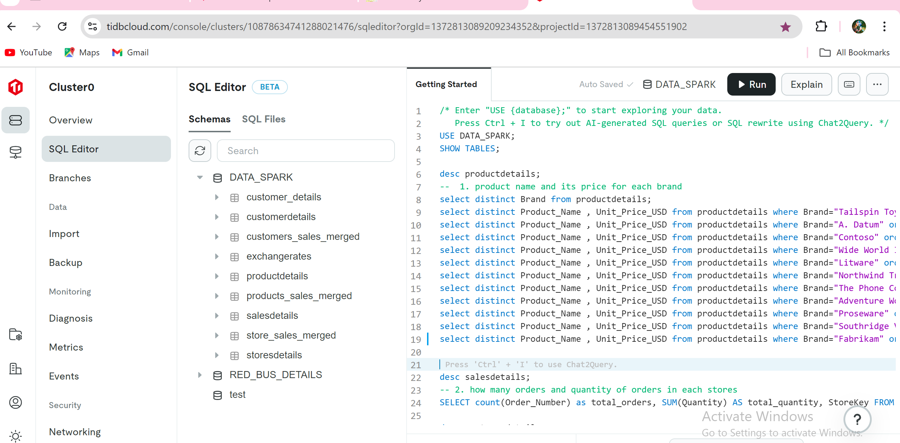
sql database QueRies

Slide 22
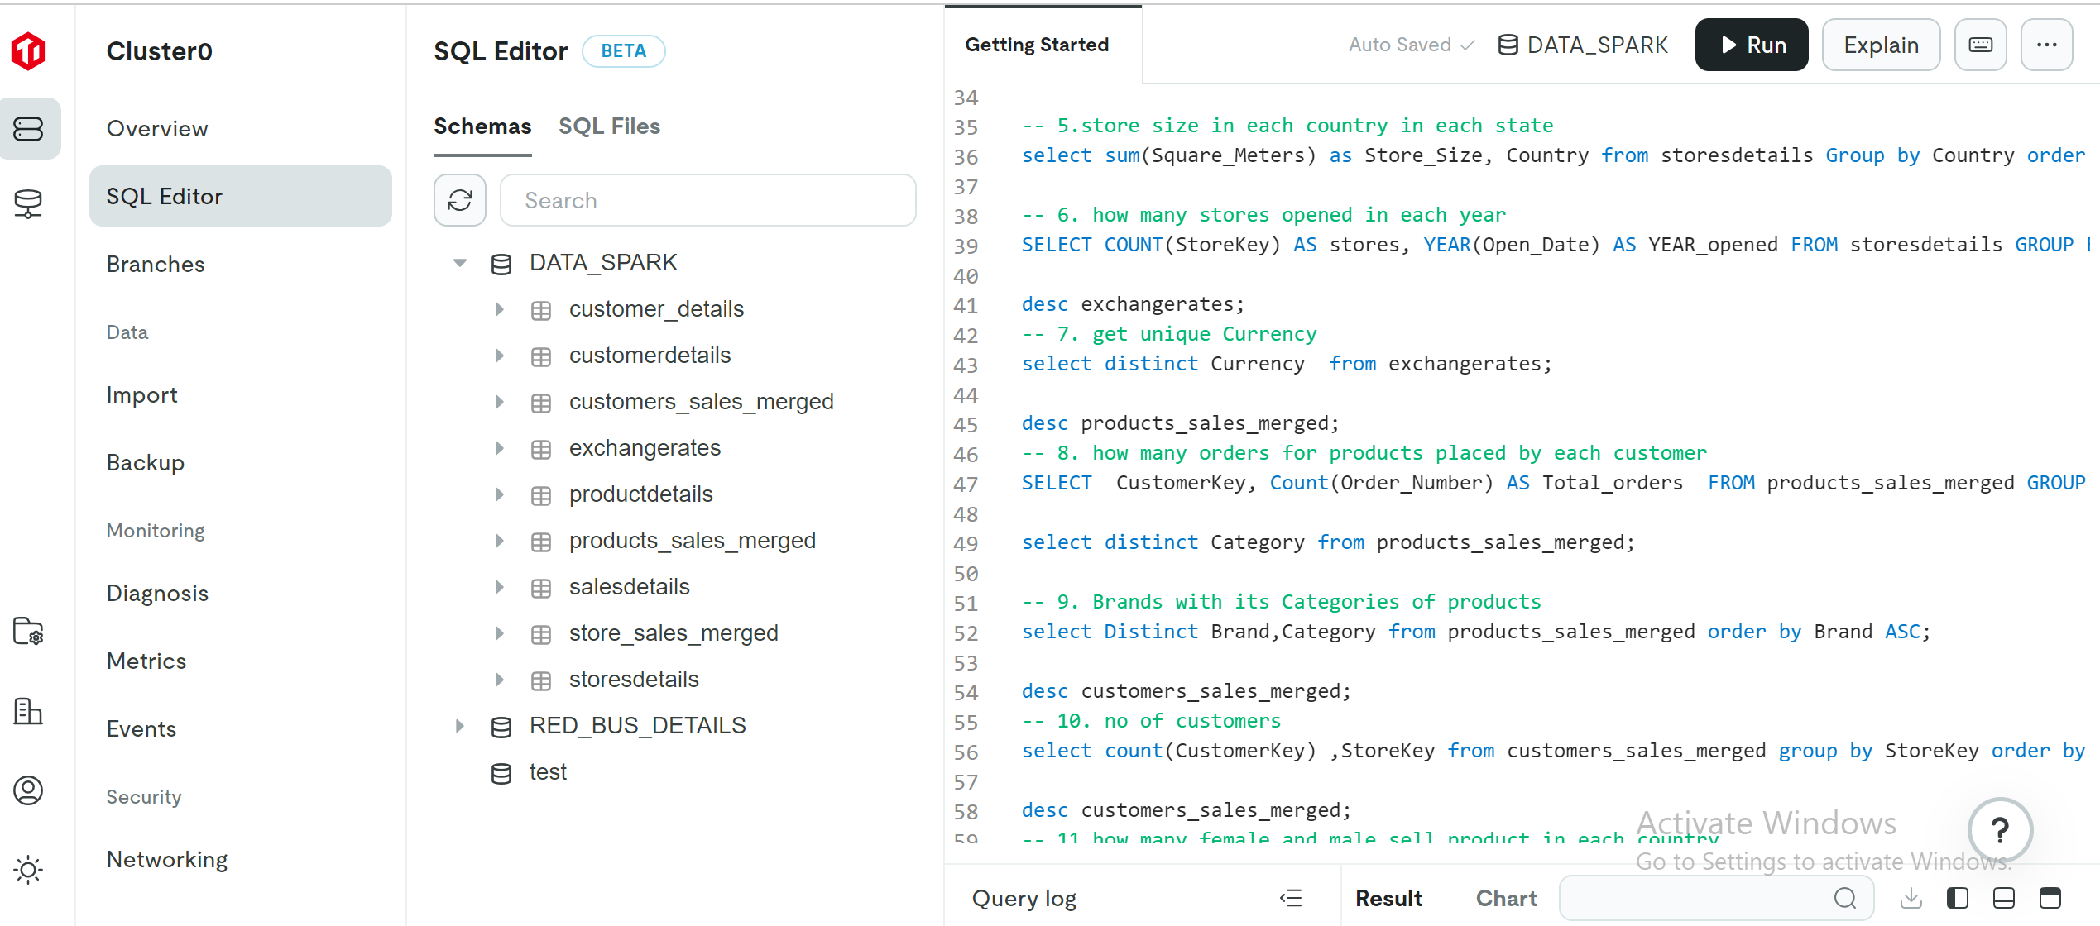

Slide 23


Power BI

Slide 24
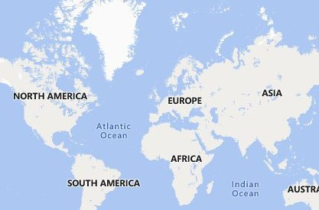


ILLUMINATING INSIGHTS FOR GLOBAL ELECTRONICS
Power BI Desktop
Year Wise Sales Value
Year Total Sales
Gender Wise Order Qty
Total Sales
55.76M
Total Qty
198K
Total Price
898.14K
Profit
55.38M
Profit margin%
99.33%
5.86K (49.…)
2016 | 69,46,793.54
2017 | 74,21,422.26
2018 | 1,27,88,960.65
2019 | 1,82,64,382.46
2020 | 92,94,632.13
2021 | 10,39,288.48
Total | 5,57,55,479.52
Gender
Male
6.03K (50.…)
Female
Country Wise Quantity Sold
Order Quantity trend By Month Wise
30K
26.9K
27.1K
United States
40K
United Kingdom
25K
25K
24.0K
Quarterly Sales Value
Year Quarter Total Sales
2016 Qtr 1 18,79,424.44
2016 Qtr 2 12,25,163.09
2016 Qtr 3 15,69,893.64
2016 Qtr 4 22,72,312.38
2017 Qtr 1 17,51,889.58
2017 Qtr 2 13,06,570.33
Germany
19K
20K
16.5K
16.3K
Country
Canada
17K
15.5K
14.8K
15.7K
15K
16.2K
Australia
9K
8.9K
13.9K
Italy
8K
10K
Netherlands
7K
5K
2.0K
2017 Qtr 3 17,91,540.87
Total 5,57,55,479.52
France
5K
0K
0K
10K
20K
Sum of Quantity
30K
40K
January
February
March
April
May
June
July
August
September
October
November
December
Country
20K
Australia
Canada
France
Germany
Italy
Netherlands
United Kingdom
United States
1bn (4.17%)
1bn (7.26%)
Country
United States
United Kingdom Canada Germany Australia Netherlands Italy
France
15K
7bn
(47.27%)
Count of StoreKey
10K
1bn (1…)
5K
1bn (10.07%)
2bn (12.36%)
0K
Male
Female
Gender
© 2024 TomTom,, © 2024 Miiccrrossofftt Corrporrattiion,, © OpenSttrreettMap

Slide 25



Power BI Desktop
Sum of Quantity
Total Unit Cost
60K
55K
Sum of Quantity and Total Unit Cost
40K
29K
30K
31K
30K
21K
22K
23K
20K
14K
15K
17K
15K
9K
12K
11K
11K
8K
10K
12K
7K
2K
5K
0K
10K
5K
10K
10K
5K
9K
4K
16K
9K
Total Unit Cost
4K
2K
3K
6K
5K
1K
5K
5K
5K
4K
5K
7K
5K
4K
4K
3K
3K
2K
2K
10K
1K
0K
0K
5K
3K
3K
1K
1K
1K
1K
3K
1K
1K
Sum of Quantity
Movie DVD
Desktops
Boxed Games
Televisions
Laptops
Microwaves
Monitors
Camcorders
MP4&MP3
VCD & DVD
Refrigerators
Car Video
Fans
Lamps
Download Games
Touch Screen Phones
Recording Pen
Projectors & Screens
Water Heaters
Digital SLR Cameras
Digital Cameras
Coffee Machines
Washers & Dryers
Air Conditioners
Bluetooth Headphones
Smart phones & PDAs
Home & Office Phones
Computers Accessories
Home Theater System
Cell phones Accessories
Printers, Scanners & Fax
Cameras & Camcorders Acc…
Subcategory
30K
Year
Quarter
Month Day
Sum of Quantity
Count of ProductKey
Brand
Subcategory

2016 Qtr 1
January
1
3
2 A. Datum
Digital SLR Cameras
25K
2016 |  | Qtr 1 |  | January |  | 1 |  | 4 |  | 1 |  | Adventure Works | Desktops
2016 Qtr 1
January
1
23
8 Adventure Works
Televisions
20K
2016 |  | Qtr 1 |  | January |  | 1 |  | 8 |  | 2 |  | Contoso | Cameras & Camcorder
Sum of Quantity
2016 Qtr 1
January
1
12
3 Contoso
Digital SLR Cameras
2016 |  | Qtr 1 |  | January |  | 1 |  | 12 |  | 4 |  | Contoso | Movie DVD
15K
2016 Qtr 1
January
1
15
3 Fabrikam
Camcorders
2016 |  | Qtr 1 |  | January |  | 1 |  | 6 |  | 3 |  | Tailspin Toys | Download Games
10K
2016 Qtr 1
January
1
5
1 Wide World Importers
Projectors & Screens
2016 |  | Qtr 1 |  | January |  | 2 |  | 4 |  | 2 |  | A. Datum | Digital Cameras
2016 Qtr 1
January
2
3
2 Adventure Works
Lamps
5K
2016 |  | Qtr 1 |  | January |  | 2 |  | 16 |  | 7 |  | Adventure Works | Televisions
2016 Qtr 1
January
2
8
2 Contoso
Movie DVD
2016 |  | Qtr 1 |  | January |  | 2 |  | 1 |  | 1 |  | Contoso | MP4&MP3
0K
2016 Qtr 1
January
2
18
6 Fabrikam
Camcorders
January
February
March
April
May
June
July
August
September
October
November
December
2016 |  | Qtr 1 |  | January |  | 2 |  | 7 |  | 2 |  | Fabrikam | Digital SLR Cameras
2016 Qtr 1
January
2
8
2 Fabrikam
Microwaves
Month
2016 |  | Qtr 1 |  | January |  | 2 |  | 9 |  | 4 |  | Litware | Fans
Total
197757
62884

Slide 26
Count of CategoryKey
0.4M
Sum of Unit_Price_USD
Count of SubcategoryKey
Sum of Unit_Cost_USD
Power BI Desktop
Count of CategoryKey, Sum of Unit_Price_USD…
0.36M
0.3M
0.2M
0.20M
0.15M
0.15M
0.11M
Sum of Unit_Price_USD
0.1M
0.06M
0.05M
0.02M
0.00M
0.08M
0.05M
Sum of Unit_Cost_USD
0.02M
0.00M
0.00M
0.00M
0.00M
0.00M
0.00M
0.00M
Count of CategoryKey
0.0M
Audio
Cameras and camcorders
Cell phones
Computers
Games and Toys
Home Appliances
Music, Movies and Audio Books
TV and Video
Category
Sum of Unit_Cost_USD and Sum of Unit_Price_USD by Subcategory
Sum of Unit_Cost_USD Sum of Unit_Price_USD
200K
Sum of Unit_Cost_USD and Sum of Unit_Price_U…
150K
100K
50K
0K
Fans
Camcorders
Refrigerators
Laptops
Lamps
Televisions
Water Heaters
Monitors
Microwaves
Desktops
Car Video
Movie DVD
MP4&MP3
Recording Pen
VCD & DVD
Boxed Games
Washers & Dryers
Projectors & Screens
Digital SLR Cameras
Coffee Machines
Air Conditioners
Digital Cameras
Download Games
Home Theater System
Smart phones & PDAs
Touch Screen Phones
Computers Accessories
Bluetooth Headphones
Home & Office Phones
Printers, Scanners & Fax
Cameras & Camcorders Accessori…
Cell phones Accessories
Subcategory

Slide 27
Sales Qty VS Value
Power BI Desktop
Subcategory Year
Air Conditioners Sum of Quantity
Bluetooth Headphones
Sum of Quantity Total Sales
1388 1,38,208.46
319 32,724.65
283 27,825.01
300 31,689.29
486 45,969.51
2069 2,06,374.93
465 46,528.45
360 38,169.45
490 44,493.26
754 77,183.77
3445 3,49,658.17
768 80,664.85
576 59,315.86
838 83,040.05
1263 1,26,637.40
4607 4,68,717.18
1243 1,27,681.42
797 80,915.11
1309 1,35,400.24
1258 1,24,720.40
1973 1,98,250.77
1074 1,12,201.25
408 42,264.58
285 26,707.10
206 17,077.84
171 19,191.25
13653 13,80,400.76
Boxed Games Sum of Quantity
Camcorders Sum of Quantity
Cameras & Camcorders Accessories Sum of Quantity Total Sales
665 59,672.21
221 19,364.20
111 12,420.25
170 13,640.45
163 14,247.31
450 34,648.88
120 11,433.15
78 6,734.74
98 7,812.08
154 8,668.91
904 76,153.83
196 12,442.54
167 13,675.44
194 15,753.24
347 34,282.61
1586 1,40,289.27
445 30,455.91
350 33,783.04
329 37,837.14
462 38,213.18
842 61,336.84
444 33,792.59
194 15,533.31
99 6,675.67
105 5,335.27
65 9,755.79
4512 3,81,856.82
Car Video
Sum of Quantity
Total Sales
Total Sales
Total Sales
Total Sa
2016
152 58,410.48
805 6,739.28
621 4,59,031.00
263 1,08,30
 Qtr 1
49 16,971.51
269 2,140.73
244 1,93,370.00
85 40,52
 Qtr 2
21 11,397.79
153 1,295.17
140
78,547.00
47 16,55
 Qtr 3
25 10,233.75
174 1,552.01
119
97,115.00
65 23,99
 Qtr 4
57 19,807.43
209 1,751.37
118
89,999.00
66 27,23
2017
171 68,464.29
779 6,543.85
516 4,15,631.00
170 76,81
 Qtr 1
39 18,807.61
178 1,529.20
160 1,31,964.00
77 32,88
 Qtr 2
24
6,865.76
67
497.32
65
58,794.00
25 14,34
 Qtr 3
56 21,523.44
197 1,570.54
105
84,518.00
26 10,86
 Qtr 4
52 21,267.48
337 2,946.79
186 1,40,355.00
42 18,72
2018
232 82,323.68
2082 17,396.82
865 6,61,700.00
280 1,07,01
 Qtr 1
64 21,589.36
327 2,716.70
137 1,11,033.00
90 37,91
 Qtr 2
42 15,029.58
362 3,303.88
147 1,00,983.00
50 16,49
 Qtr 3
33 14,945.67
491 3,896.61
199 1,53,395.00
69 25,66
 Qtr 4
93 30,759.07
902 7,479.63
382 2,96,289.00
71 26,94
2019
212 84,255.88
4563 36,989.97
1588 11,37,509.00
382 1,70,05
 Qtr 1
66 25,307.34
1030 8,556.77
362 2,67,977.00
86 34,08
 Qtr 2
44 16,737.56
790 6,272.18
272 1,80,461.00
74 24,48
 Qtr 3
45 17,905.55
1286 10,552.23
434 2,95,607.00
105 57,19
 Qtr 4
57 24,305.43
1457 11,608.79
520 3,93,464.00
117 54,28
2020
103 35,284.97
2596 22,441.53
798 6,18,898.00
241 1,14,22
 Qtr 1
61 19,639.39
1349 11,650.08
433 3,50,239.00
149 71,41
 Qtr 2
13
5,121.87
465 4,092.05
189 1,40,202.00
22
7,08
 Qtr 3
14
6,707.86
406 3,524.12
83
58,537.00
55 29,55
 Qtr 4
15
3,815.85
376 3,175.28
93
69,920.00
15
6,16
2021
14
4,845.86
219 1,839.61
94
65,221.00
27 11,48
Total
884 3,33,585.15
11044 91,951.06
4482 33,57,990.00
1363 5,87,88
This table shows yearly sales products quantity and value
Growth and Decline: The data indicates a period of growth in sales from 2016 to 2019, peaking in 2019. After that, there is a significant decline in 2020 and 2021.-49.08-88.83 Growth and Decline: The

Slide 28
Power BI Desktop
Month
Month
Subcategory
Brand
Total Qty
Sum of Unit_Cost_USD
Sum of Unit_Price_USD
Profit margin%
V
V
Desktops | Adventure Works | 1267 | 5,140.29 | 11,766.30 | 99.23%
Desktops | Wide World Importers | 1173 | 4,187.84 | 9,788.90 | 99.13%
Movie DVD | Contoso | 1844 | 1,894.92 | 4,866.57 | 99.10%
Movie DVD | Southridge Video | 1723 | 1,894.92 | 4,866.57 | 98.97%
Recording Pen | Wide World Importers | 744 | 1,723.75 | 3,962.65 | 98.89%
Bluetooth Headphones | Wide World Importers | 783 | 1,323.99 | 3,191.90 | 98.78%
Bluetooth Headphones | Northwind Traders | 823 | 782.00 | 1,899.01 | 98.65%
Boxed Games | Tailspin Toys | 804 | 87.20 | 201.00 | 98.65%
Boxed Games | Southridge Video | 563 | 78.71 | 178.47 | 98.30%
Cell phones Accessories | Contoso | 654 | 294.44 | 714.11 | 98.11%
Touch Screen Phones | The Phone Company | 1092 | 6,557.88 | 15,198.00 | 97.99%
Water Heaters | Contoso | 645 | 10,281.03 | 24,331.50 | 97.94%
Touch Screen Phones | Contoso | 233 | 1,316.13 | 2,862.00 | 97.85%
VCD & DVD | Southridge Video | 349 | 1,238.48 | 2,799.00 | 96.83%
Televisions | Adventure Works | 704 | 14,506.26 | 37,435.22 | 96.78%
Smart phones & PDAs | The Phone Company | 1256 | 12,230.73 | 28,301.00 | 96.52%
MP4&MP3 | Contoso | 481 | 2,737.43 | 6,572.53 | 96.23%
Download Games | Tailspin Toys | 1330 | 3,035.25 | 6,680.86 | 96.02%
Laptops | Proseware | 116 | 3,474.60 | 8,127.90 | 95.80%
Laptops | Adventure Works | 231 | 8,171.72 | 19,235.75 | 94.98%
Monitors | Proseware | 206 | 3,279.86 | 8,692.00 | 94.66%
Projectors & Screens | Proseware | 191 | 9,962.16 | 26,001.00 | 94.46%
Laptops | Wide World Importers | 116 | 4,226.42 | 10,125.90 | 94.37%
Cameras & Camcorders Accessories | Contoso | 606 | 2,632.49 | 6,327.50 | 94.09%
Laptops | Fabrikam | 211 | 6,126.08 | 13,450.15 | 93.99%
Camcorders | Fabrikam | 657 | 30,894.30 | 77,510.00 | 93.92%
Digital SLR Cameras | Contoso | 196 | 5,660.78 | 14,968.00 | 93.90%
Monitors | Adventure Works | 148 | 3,278.80 | 8,774.00 | 93.64%
Home & Office Phones | Contoso | 581 | 1,210.03 | 2,763.24 | 93.33%
Total |  | 24018 | 3,71,649.05 | 8,98,141.44 | 94.50%
Sales Year
Year

2016
January
February
March
April
May
June
July
August
September
October
November
December
2017
2018
2019
2020
2021
Profit Range
Year
Total Sales
Profit
Profit margin%
 | 2016 | 6,49,918.78 | 2,78,269.73 | 42.82%
 | 2017 | 6,70,114.80 | 2,98,465.75 | 44.54%
 | 2018 | 9,17,075.35 | 5,45,426.30 | 59.47%
 | 2019 | 19,40,899.57 | 15,69,250.52 | 80.85%
 | 2020 | 20,68,951.12 | 16,97,302.07 | 82.04%
 | 2021 | 5,13,021.58 | 1,41,372.53 | 27.56%
Total |  | 67,59,981.19 | 63,88,332.14 | 94.50%
Profit Percentage Fluctuations: The profit percentages show large fluctuations. After a modest increase of 44.54% in 2017, there's a sharp rise of 59.47% in 2018 followed by a gain of 80.85% in 2019 and also gain 82.04%. Subsequently, there are significant declines 27.56% in 2021

Slide 29
Enhance Product and Service Offerings
•Product Innovation: Continuously innovate and improve your products or services based on market trends and customer feedback.
•Diversification: Expand your product line to cater to a wider range of customer needs or enter new markets.
•Quality Assurance: Ensure high-quality standards for your products or services to build trust and encourage repeat purchases. Optimize Pricing Strategies without compromising profitability.
•Competitive Pricing: Analyze competitor pricing and adjust your pricing strategy to remain competitive
•Dynamic Pricing: Implement dynamic pricing models that adjust prices based on demand, customer segments, or market conditions.
•Bundling and Discounts: Offer product bundles or discounts to incentivize purchases and increase average order value.

Slide 30


Thank You

